Slide 1
CS 350/SE 310 Final Review
CS350, Fall 2015

Slide 2
Software Design
Two goals:
Fulfill functionality
Localize and minimize changes
Reflect designer’s thoughts in code. Good design requires:
Follow good design principles
Solid programming skills
Software Design in General
Data structure, interfaces and logic
Software Design in OO
Classes with data structure, interfaces and logic

Slide 3
The fundamentals
Abstraction and Modularization
How to apply Abstraction and Modularization in
Software Design
OO Design
Design principles
General design principles:
Information Hiding—Hide data structure, hide details, hide variations
Low coupling, High cohesion
Least of Knowledge
OO design principles (SOLID)
Single Responsibility Principle
Open Close Principle
Liskov Substitution Principle
Interface Segregation Principle
Dependency Inversion Principle

Slide 4
General Design Principles
Information Hiding
Hide data
Do not expose internal data structure!
Be careful about getter and setter!
Hide details
Hide variation
High cohesion, low coupling
Methods should only access data within their class
A function should always access the same data.
Least of Knowledge

Slide 5
SOLID
Single Responsibility Principle: there can be only one reason for a class to change.
Use separate classes for different set of functionality
No function should have two purposes.
Open Close Principle: Classes and methods should be open for extension but closed for modification.
Always think about future changes
Liskov Substitution Principle: Every function or method which expects an object parameter of class A must be able to accept a subclass of A as well, without knowing it.
Forget Is-a when you design an heritance hierarchy
Interface Segregation Principle: Classes should not depend on interfaces that they not use.
Interface design should also have high cohesion
Single responsibility principle applied at Interface design
Dependency Inversion Principle: High level classes should not depend on low level classes. Both should depend upon abstractions. Details should depend upon abstractions. Abstractions should not depend upon details.
Favor composition over inheritance
Try you best not to inherit from a common class
Use interfaces to abstract the commonality between classes, and only depend on the interfaces

Slide 6
Localize and minimize changes
A design can only follow these principles under some circumstances.
Changes can only be localized to certain extend.
Crosscutting changes are inevitable

Slide 7
Design Patterns
Patterns we have learned
Creational
Factory Method, Abstract Factory, Builder, Prototype, Singleton
Behavioral
Command, Strategy, Observer, Mediator, Iterator, Visitor, Template Method
Structural
Composite, Bridge, Adapter, Façade, Decorator
Their UML diagrams
Their similarity and differences
Not all patterns follow all the principles

Slide 8
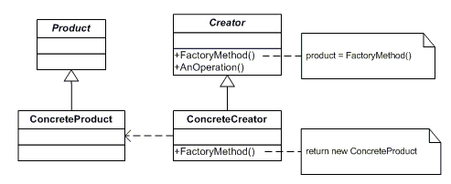
Abstraction and Modularization In OO
Abstraction
Design interfaces
Design abstract methods
Modularization
Data encapsulation
Shift responsibility
Language support
Encapsulation
Inheritance
Polymorphism

Slide 9
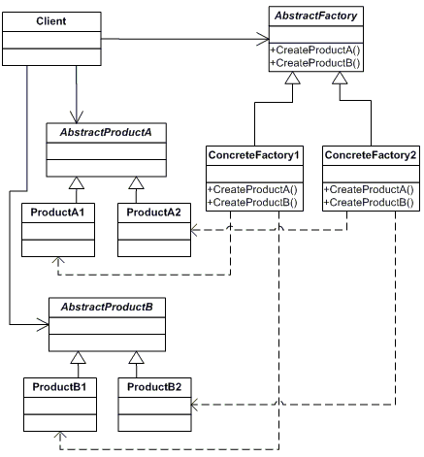
Abstraction and Modularization In OO
Design Skills
Abstraction
Design interfaces
Design abstract methods
Modularization
Data encapsulation
Shift responsibility
Language support
Encapsulation
Inheritance
Polymorphism

Slide 10
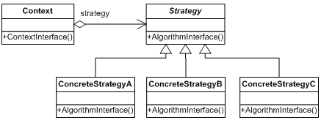
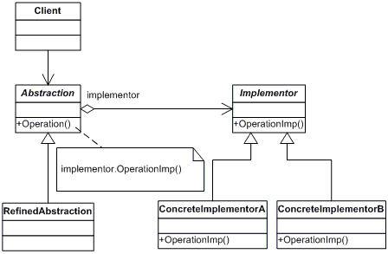
Abstraction and Modularization In OO
Design Skills
Abstraction
Design interfaces
Design abstract methods
Modularization
Data encapsulation
Shift responsibility
Language support
Encapsulation
Inheritance
Polymorphism

Slide 11
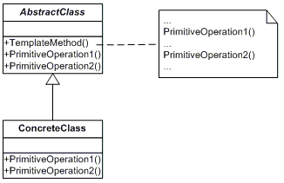
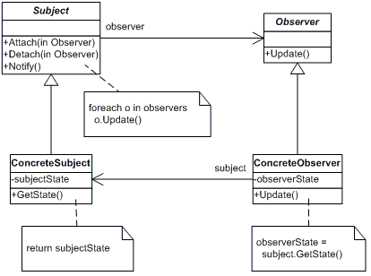
Abstraction and Modularization In OO
Design Skills
Abstraction
Design interfaces
Design abstract methods
Modularization
Data encapsulation
Shift responsibility
Language support
Encapsulation
Inheritance
Polymorphism

Slide 12
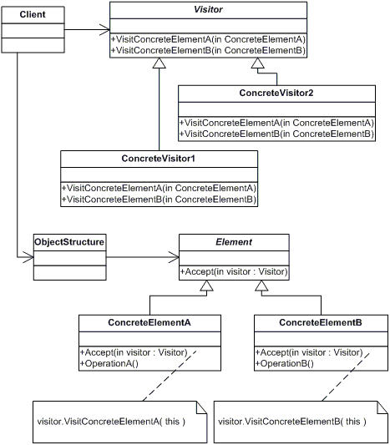
Abstraction and Modularization In OO
Design Skills
Abstraction
Design abstract interfaces
Design abstract methods
Modularization
Data encapsulation
Shift responsibility
Language support
Encapsulation
Inheritance
Polymorphism

Slide 13
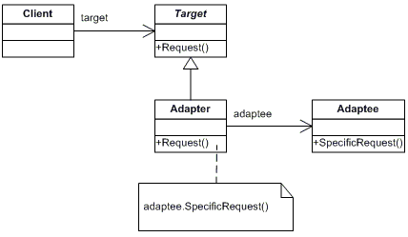
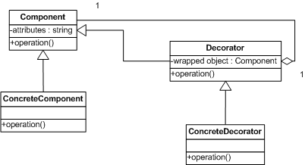
Abstraction and Modularization In OO
Design Skills
Abstraction
Design interfaces
Design abstract methods
Modularization
Data encapsulation
Shift responsibility
Language support
Encapsulation
Inheritance
Polymorphism

Slide 14
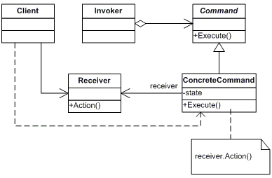
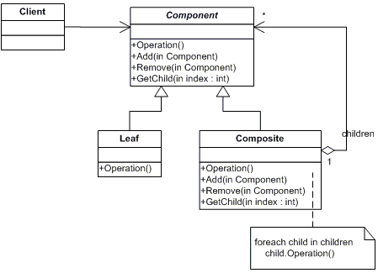
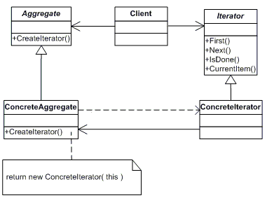
Abstraction and Modularization In OO
Design Skills
Abstraction
Design interfaces
Design abstract methods
Modularization
Data encapsulation
Shift responsibility
Language support
Encapsulation
Inheritance
Polymorphism

Slide 15
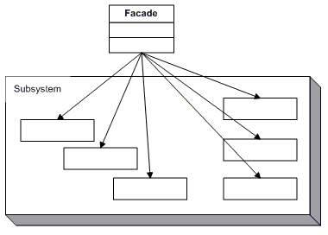
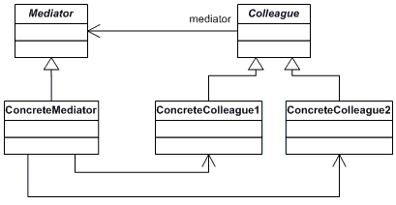
Abstraction and Modularization In OO
Design Skills
Abstraction
Design interfaces
Design abstract methods
Modularization
Data encapsulation
Shift responsibility
Language support
Encapsulation
Inheritance
Polymorphism

Slide 16
Final Exam Review
Questions?

